Slide 1
The Big Fit project
Presented By:
Yi Zhuang
Serena Villacorta
Alaa Alhiadari
Seher Mumtaz
IST-303
Professor:
Dr. Wallace Chipidza

Slide 2
What our application is about
A weight tracking website.
Customer: Dr.Chipidza
Owner: The project group-all member in Group-1
Stakeholders

Slide 3
User Stories for milestone1.0
As a customer, i should be able to register, so that the system will have my account information.
As a customer, i should be able to log in, so that i could use the functions based on login.
As a customer, i should be able to log out, so that i could change my account.
As a customer, i should be able to enter my weight, so that i could track my daily weight.
As a customer, i should be able to visit my weight history, so that i can see the history of my weight.

Slide 4
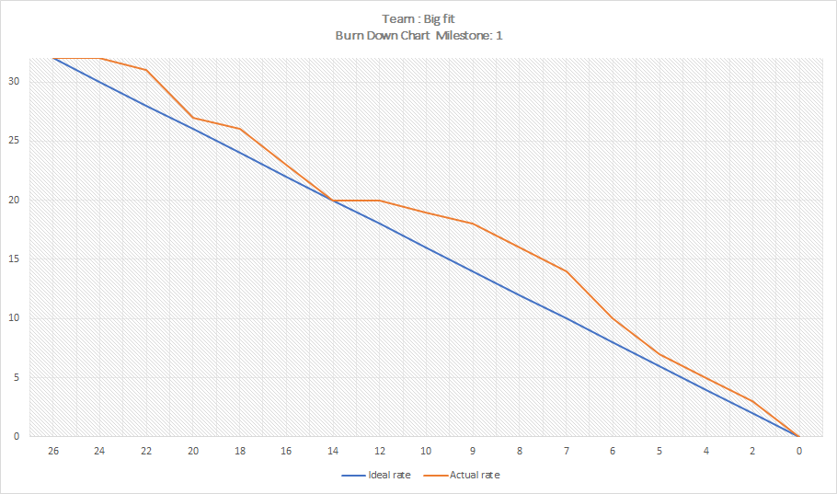
Burndown chart & velocity
Iteration 1:
Oct4 - Oct15
Iteration 2:
Oct16 - Nov8
Total Days of work=
26 days (Oct 4 - Nov 8)
Velocity = 30% or 0.3
4 * 26 * 0.3 = 31
Is the amount of work we needed to finish

Slide 5
Django
High level Python Web Framework
Encourages rapid development and clean, pragmatic design
Takes care of the hassle of web development so that you can focus on writing your app without reinventing the wheel

Slide 6
MTV
Model – Django ORM
Templates
Views – python functions (request/response)

Slide 7
Model
Demo

Slide 8
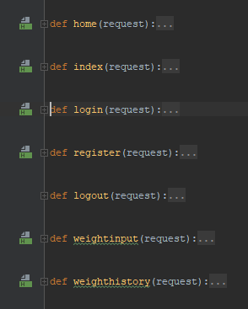
Views.py
A view function is a Python function that takes a Web request and returns a Web response. It is the place for you to write all the functions you want to achieve in the webpage.

Slide 9
Templates- GUI
-Django Web framework has templates to integrate HTML5
-A template contains the static parts of the desired HTML
-Special syntax describing how dynamic content will be inserted.
-Django defines a standard API for loading and rendering templates regardless of the backend.

Slide 10
GUI - pages
Index or home
Sign up
Personal Details
About
Contact us
Logout

Slide 11
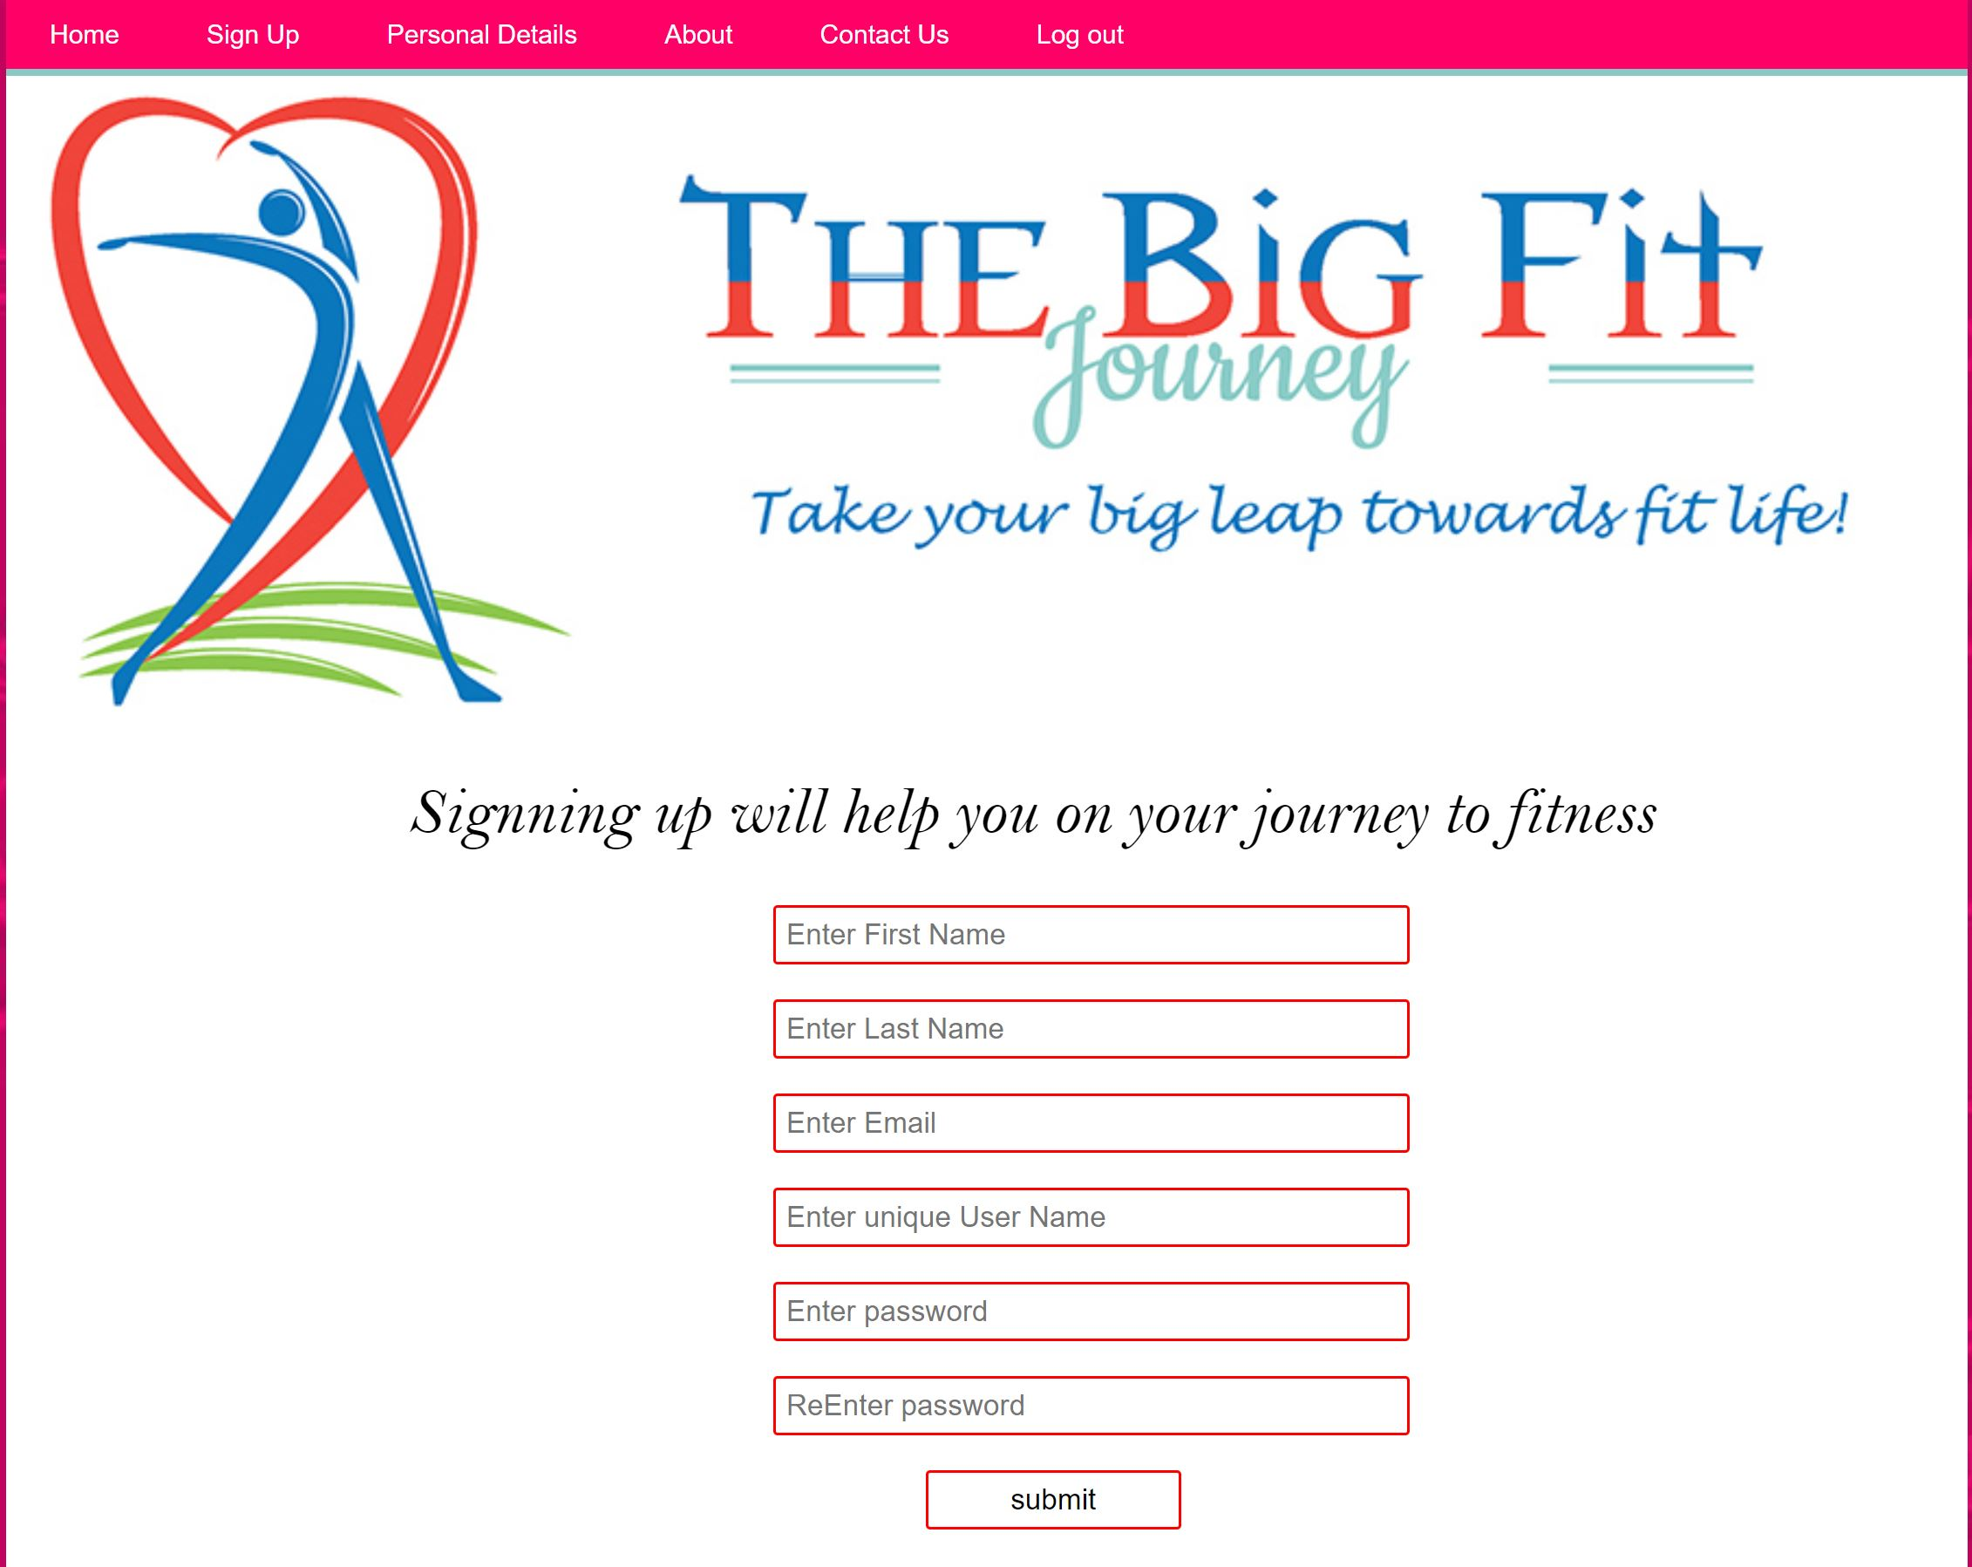
GUI - Sign up page

Slide 12
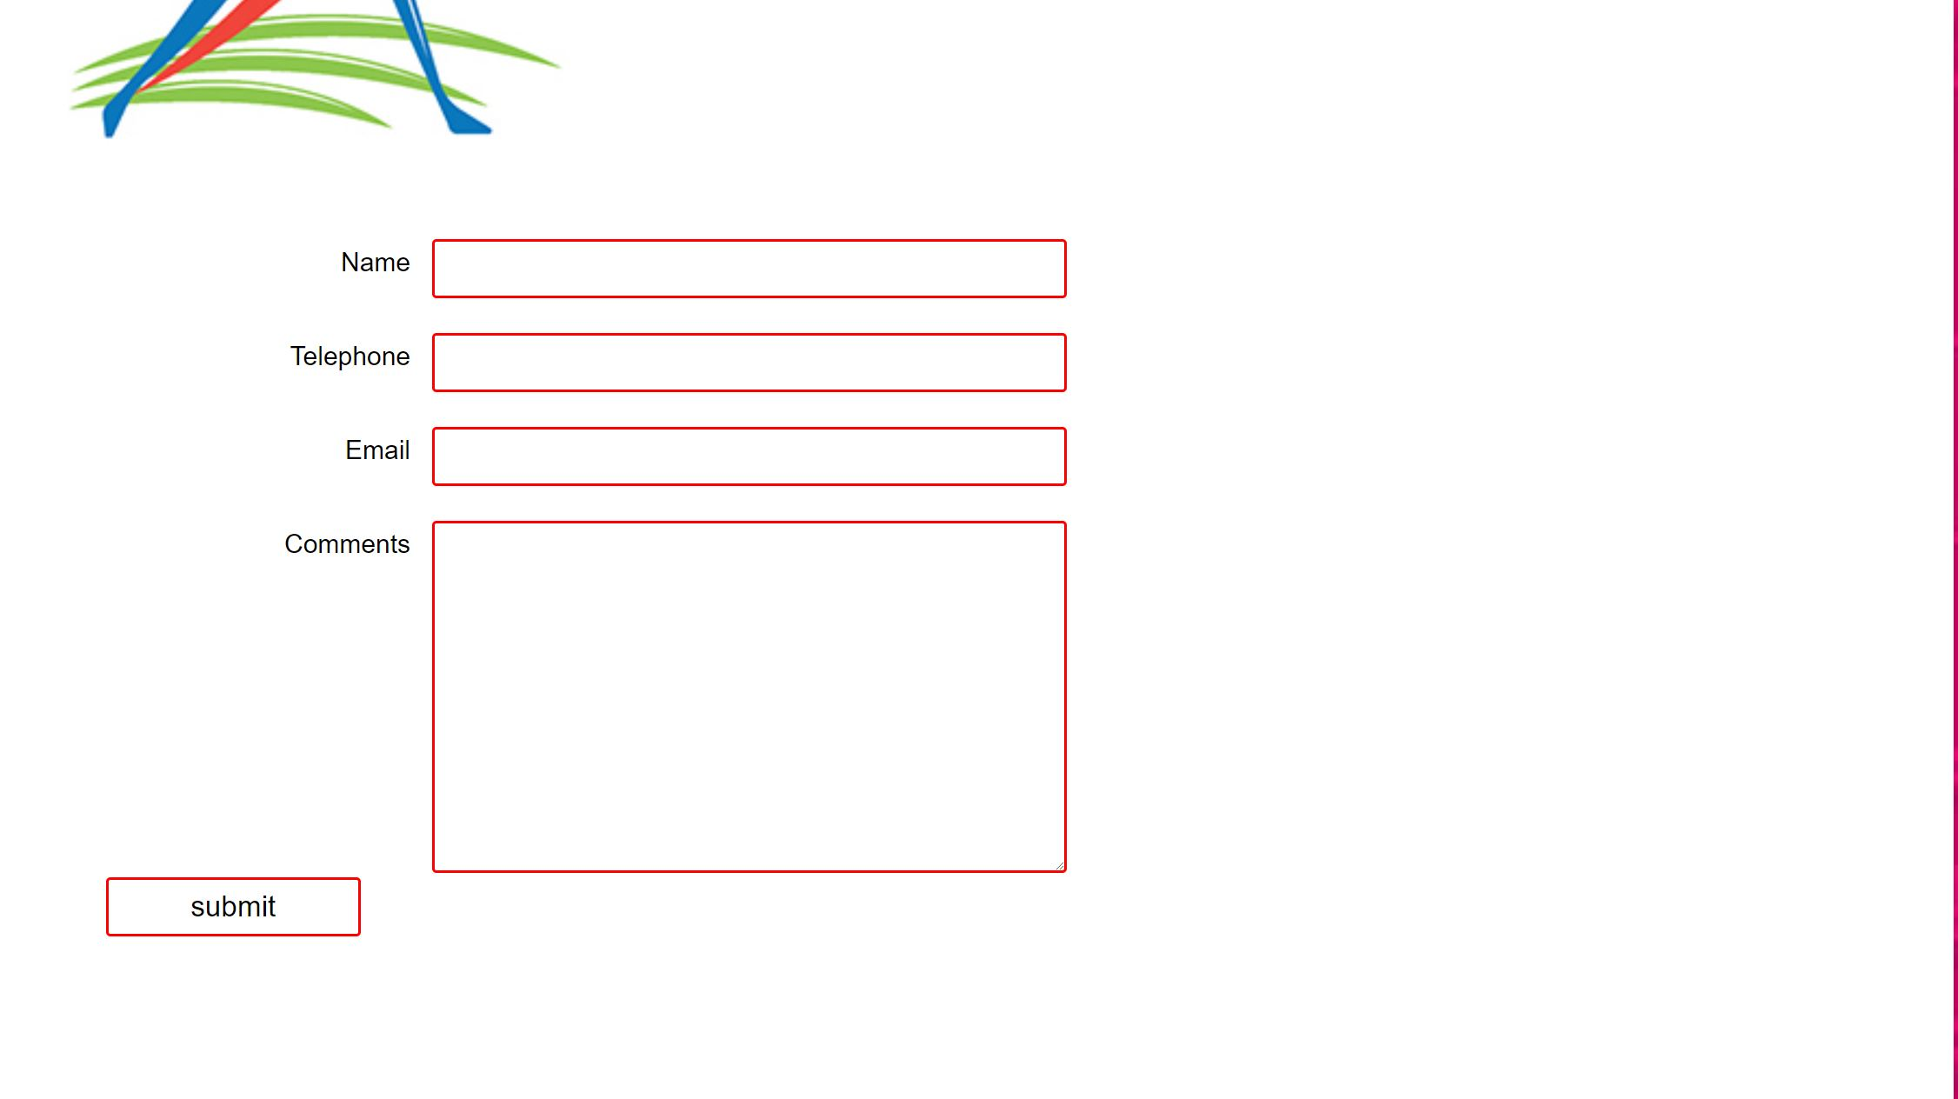
GUI - Contact us page

Slide 13
Pytests
Three Main things to test in our system
· Models
· Views
· Forms
Testing:
- Test URL: Test if the function we created match our URL Page
- Test. Environment: If the websites give us http response to our page like not found , not excite
- Test. Models: We are testing the user info to get if user was able to get his/her registration successful in the website with the right format

Slide 14
Sources
https://www.djangoproject.com

Slide 15
Questions?

